Slide 1

G. H. Raisoni Institute of Engineering and Technology, Wagholi, Pune
Department of Computer
PROJECT NAME
Real-time Sign Language To English Language Conversion Using CNN For Disabled People
GROUP MEMBERS
Vaibhavi Padamwar
Sandeep Malviya
Harshada Patil
Sanghavi Appam
GUIDE NAME
Prof. Disha Deotale

Slide 2
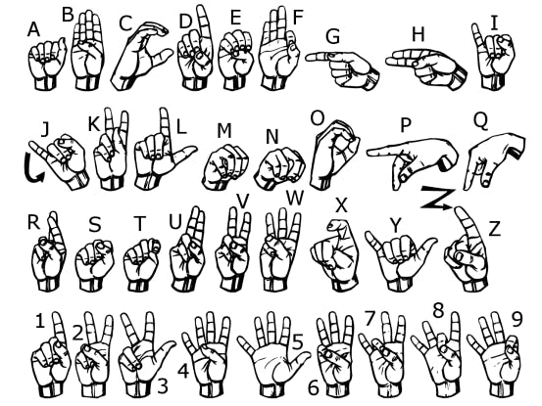
INTRODUCTION
There are people who are facing illnesses such as deafness or dumbness. They face difficulty interacting with others. Previously developed techniques are all sensors based and they didn’t give the general solution.
This presentation explains a new technique of virtual talking without sensors. Convolutional Neural Network has been used to train the System. Web Camera is used to take the image of different gestures and that will be used as input to the MATLAB.
The software will recognize the image and identify the cores sign language and convert them to English language and give voice output using a voice replay kit.
Such as two-way communications between the dumb and normal people would be capable by converting the sign language to text and voice for various uses such as on video conference.

Slide 3
PROBLEM STATEMENT
Around 46 Million people in the world are handicap who can’t speak or listen properly.
Dumb people use hand signs to communicate, hence normal people face problem in recognizing their language by signs made.
The hearing impaired people always have problem in communicating with normal people.
They have problem in conveying their thoughts and ideas to normal people who have very limited or sometimes no knowledge in sign language.
This makes the hearing impaired community lose interest in common activities and they avoid communicating with normal people at times and live in isolation.

Slide 4
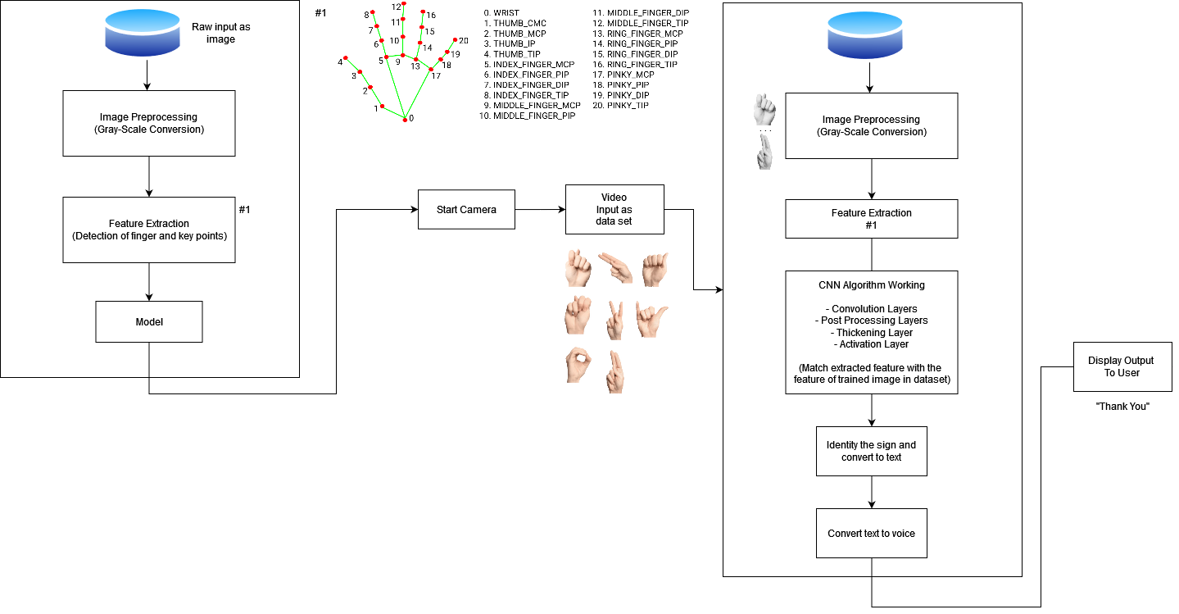
System Architecture
Test module
Train module
Text as a output

Slide 5
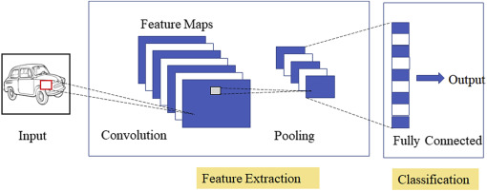
Methodology
Modeling Stage
System would take, video feed as input, from which Image would be extracted.
Image would be cropped and scaled to fixed ratio.
Colored image would be converted to grayscale image
Convolutional Layer
In a typical neural network each input neuron is connected to the next hidden layer.
In CNN, only a small region of the input layer neurons connect to the neuron hidden layer.
CNN Algorithm
Connect with frontend
Collection Of Data
Training Model
(CNN Algorithm)
Real Time Application

Slide 6
… Methodology
Fully-Connected layer
Fully Connected Layers form the last few layers in the network.
The input to the fully connected layer is the output from the final Pooling or Convolutional Layer, which is flattened and then fed into the fully connected layer.
Pooling Layer
The pooling layer is used to reduce the dimensionality of the feature map.
There will be multiple activation & pooling layers inside the hidden layer of the CNN.

Slide 7
… Methodology
Visual Stage
After previous steps, a predicted text would be given as output
We would convert the text-to-voice using the reliable python voice kit
Audio would be played after conversion

Slide 8

Data Flow Diagram
DFD0

Slide 9
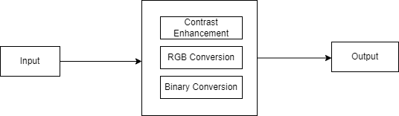
… Data Flow Diagram
DFD1

Slide 10
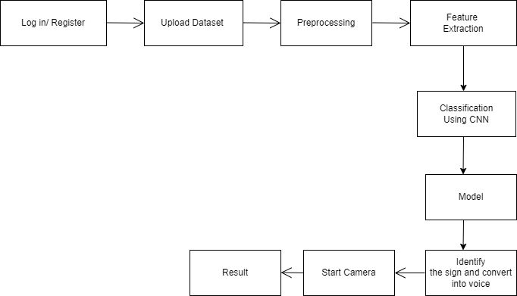
… Data Flow Diagram
DFD2

Slide 11
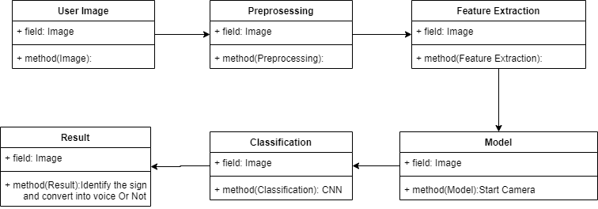
UML Diagram
CLASS

Slide 12
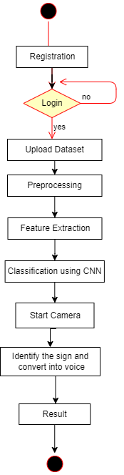
… UML Diagram
ACTIVITY

Slide 13
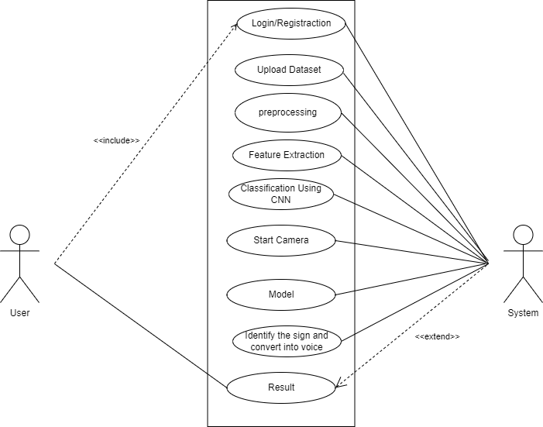
… UML Diagram
USE CASE

Slide 14
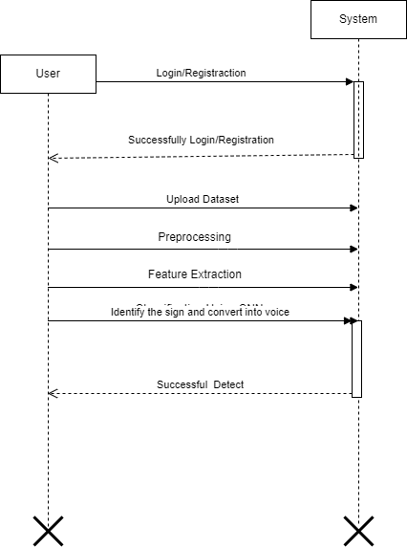
… UML Diagram
SEQUENCE

Slide 15
Python Function Used
Tensorflow
Keras
Numpy
Matplotlib

Slide 16
Code General Info
  For Training
  2002 Image
  For Testing
      44 Images
  Batch Size
      10
  Epoch
      10

Slide 17
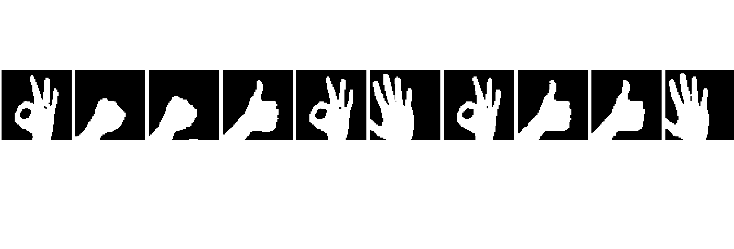
Trained Sign
I am good, how you?
Good! See you later.
Good! See you later.
I am fine, all okay
I am good, how you?
Hello! How are you?
I am good, how you?
I am fine, all okay
I am fine, all okay
Hello! How are you?

Slide 18
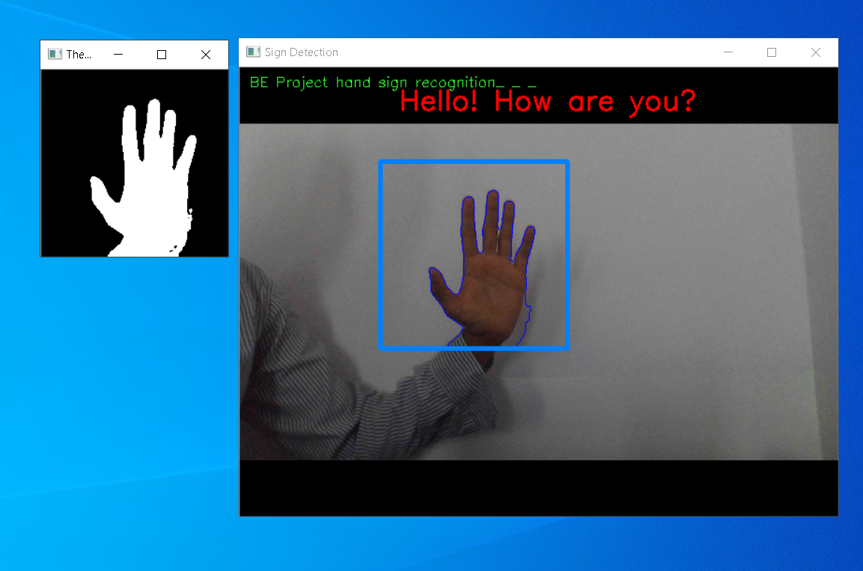
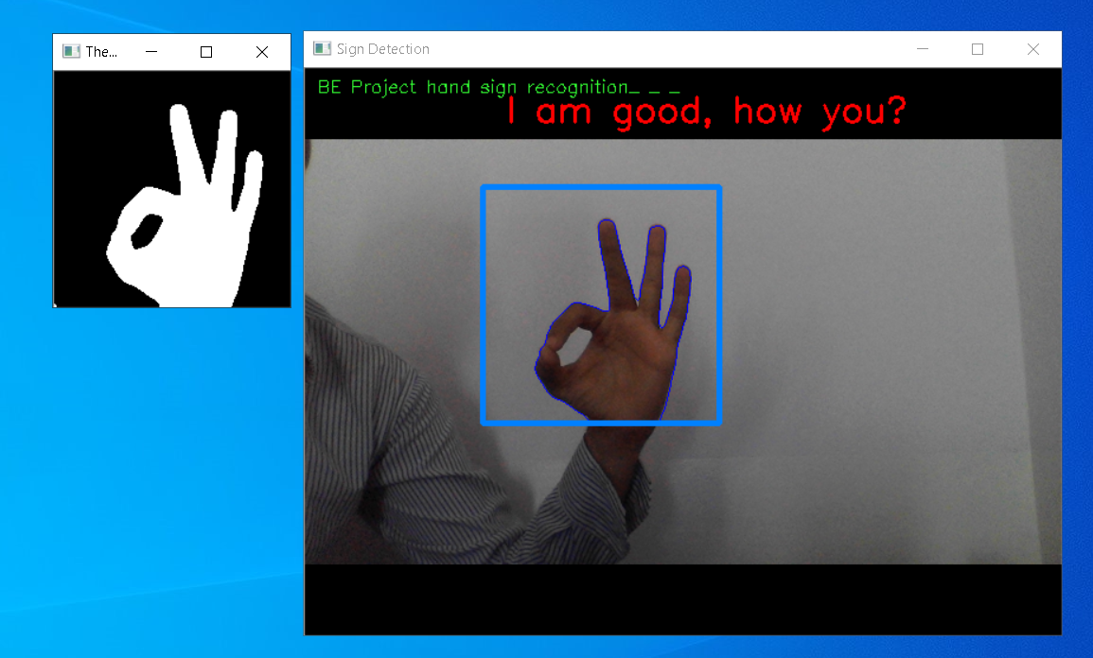
Code Output

Slide 19
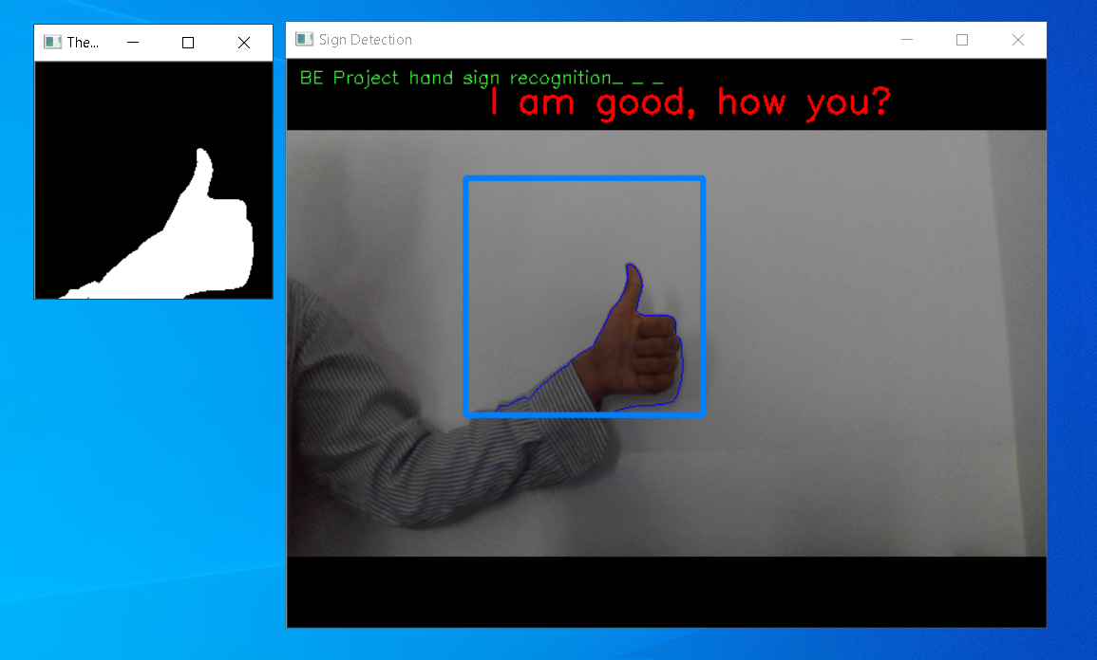
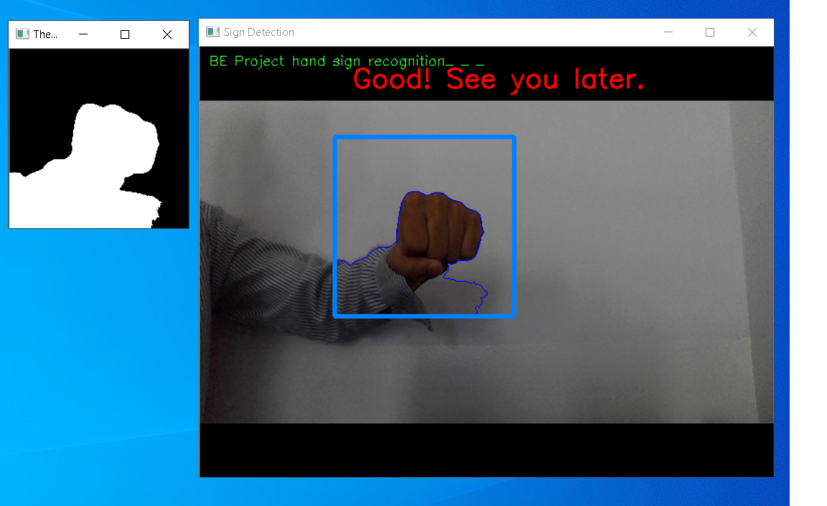
Code Output…

Slide 20
Minimum Hardware & Software Requirement
Software Requirements:
Operating system : 64 bit Windows 10
Coding Language : Python
Design constraints : Spyder
Hardware Requirements:
System Processors : Intel i5
Speed : 2.4 GHz
Hard Disk : 150 GB
RAM : 8 GB
Graphic Card : 2 GB

Slide 21
Conclusion
A neural network based method for automatically recognizing the finger spelling in Indian sign language is developed in this project.
The signs are identified by the features extracted from the hand shapes.
The method is implemented completely by utilizing digital image processing techniques so the user does not have to wear any special hardware device or gloves to get the features of the hand shape.
Our proposed method has low computational complexity and very high accuracy when compared to the existing methods.

Slide 22
Thank You

